Slide 1
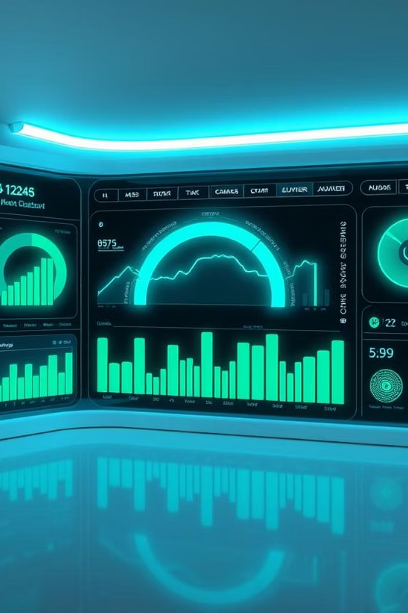
Smart Electricity Consumption Monitoring System (SECMS)
Real-time, AI-powered Energy Monitoring for Smarter Living
PhantomTeam | Agentic AI Hackathon 2025 (Google Cloud)

Slide 2
The Problem: Inefficient Energy Management
No Real-time Data
Energy Wastage
Traditional meters offer no immediate usage insights.
Leads to excessive consumption and inefficient habits.
Billing Inaccuracies
No Appliance Insights
Lack of transparency causes disputes and distrust.
Users can't identify high-energy devices.
Approximately 30% of residential electricity is wasted due to these inefficiencies.

Slide 3
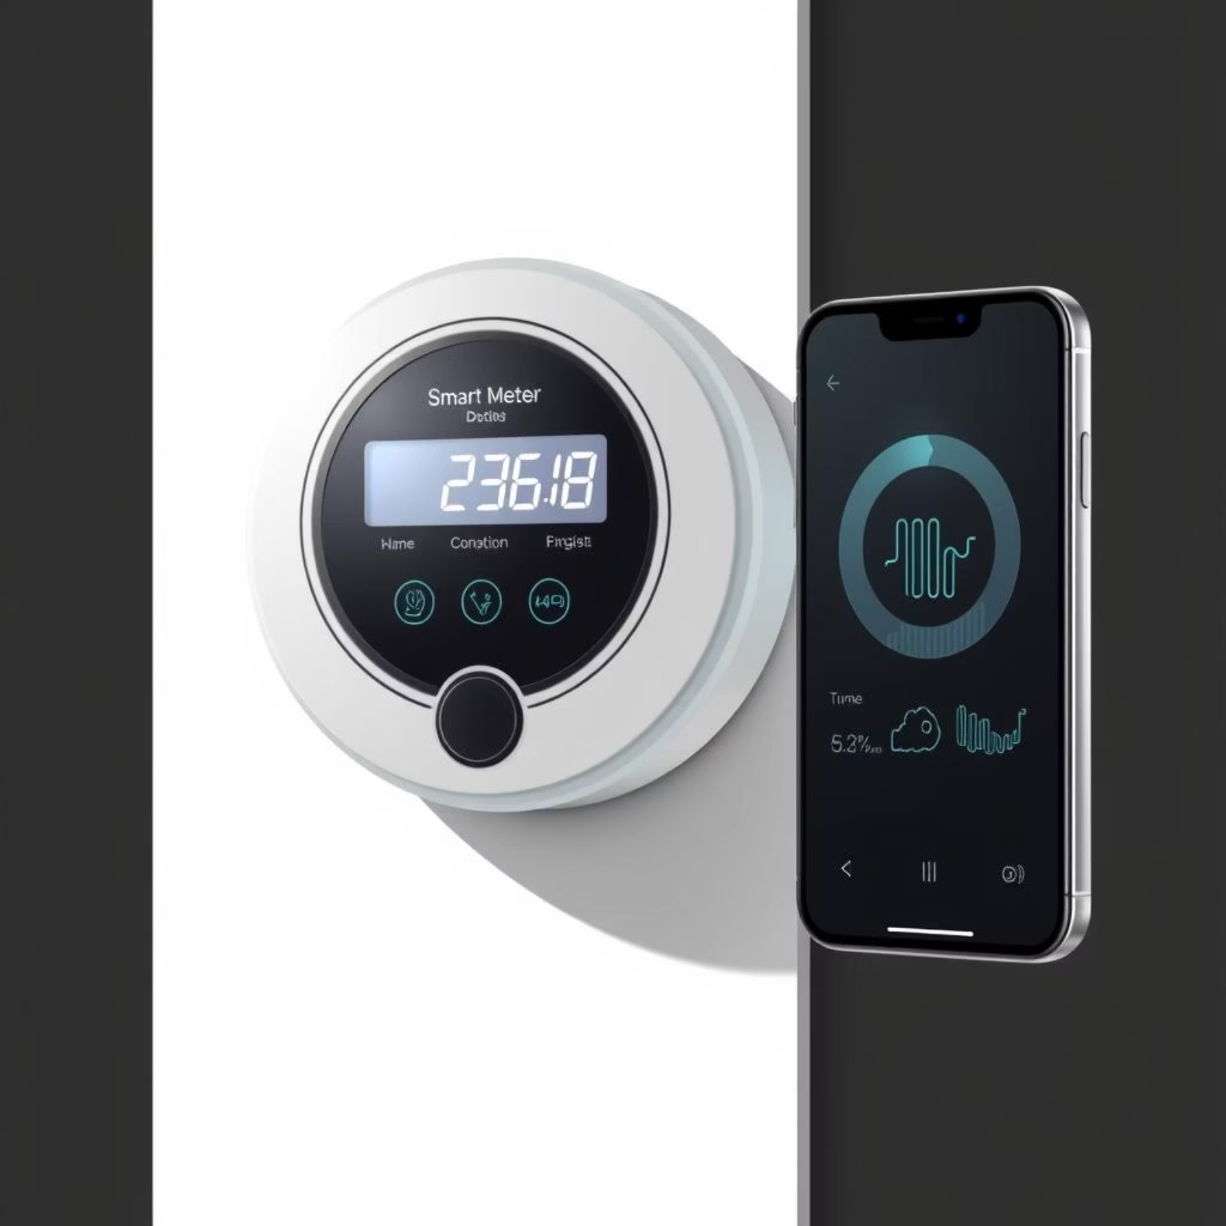
Our Solution: SECMS
SECMS is an innovative IoT-enhanced retrofit module that transforms existing electricity meters into smart, real-time monitoring systems.
Real-time usage tracking
AI-powered consumption analysis
Secure bill payments
Personalized energy-saving goals
Affordable: ₹9500 per household
Aligns with SDG 7: Affordable and Clean Energy

Slide 4
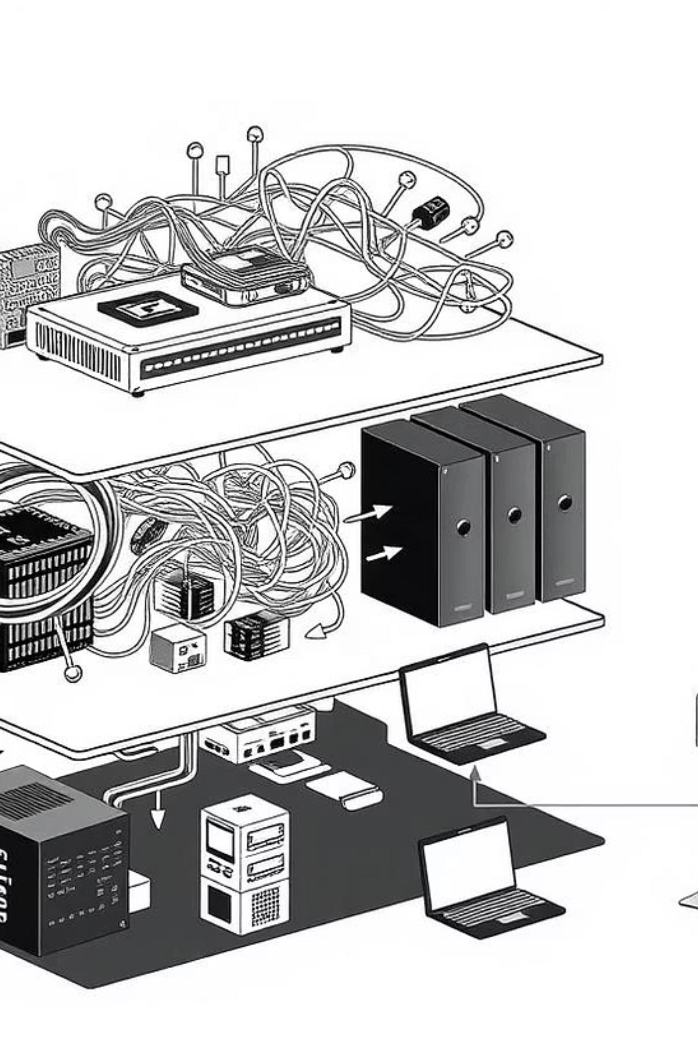




System Architecture
Hardware Layer
Microcontroller (Arduino/RPi), current/voltage sensors, communication modules.
Connectivity Layer
Secure data transmission via Wi-Fi or LoRa to cloud servers.
Data Processing Layer
Cloud servers analyze consumption using AI and data analytics.
Application Layer
Mobile app interface for users and utility providers.

Slide 5






Key Features
Real-time Monitoring
AI Insights & Goals
Track consumption via mobile app.
Optimize usage with smart recommendations.
Peer Comparison
Secure Payments
Compare usage with others.
Government-authorized bill payments.
WattFinder Module
Dynamic Alerts
Appliance-level consumption insights.
Anomaly detection and usage alerts.

Slide 6
Competitive Analysis
Installation
Retrofit
Retrofit
New Meter
Software
Appliance Monitoring
Yes (WattFinder)
Yes
Limited
Yes
AI Features
Advanced
Basic
Limited
Advanced
Affordability
₹9500
High
Medium
High
SDG Alignment
Yes
Partial
Partial
Partial
Payment Integration
Yes
No
Yes
No

Slide 7
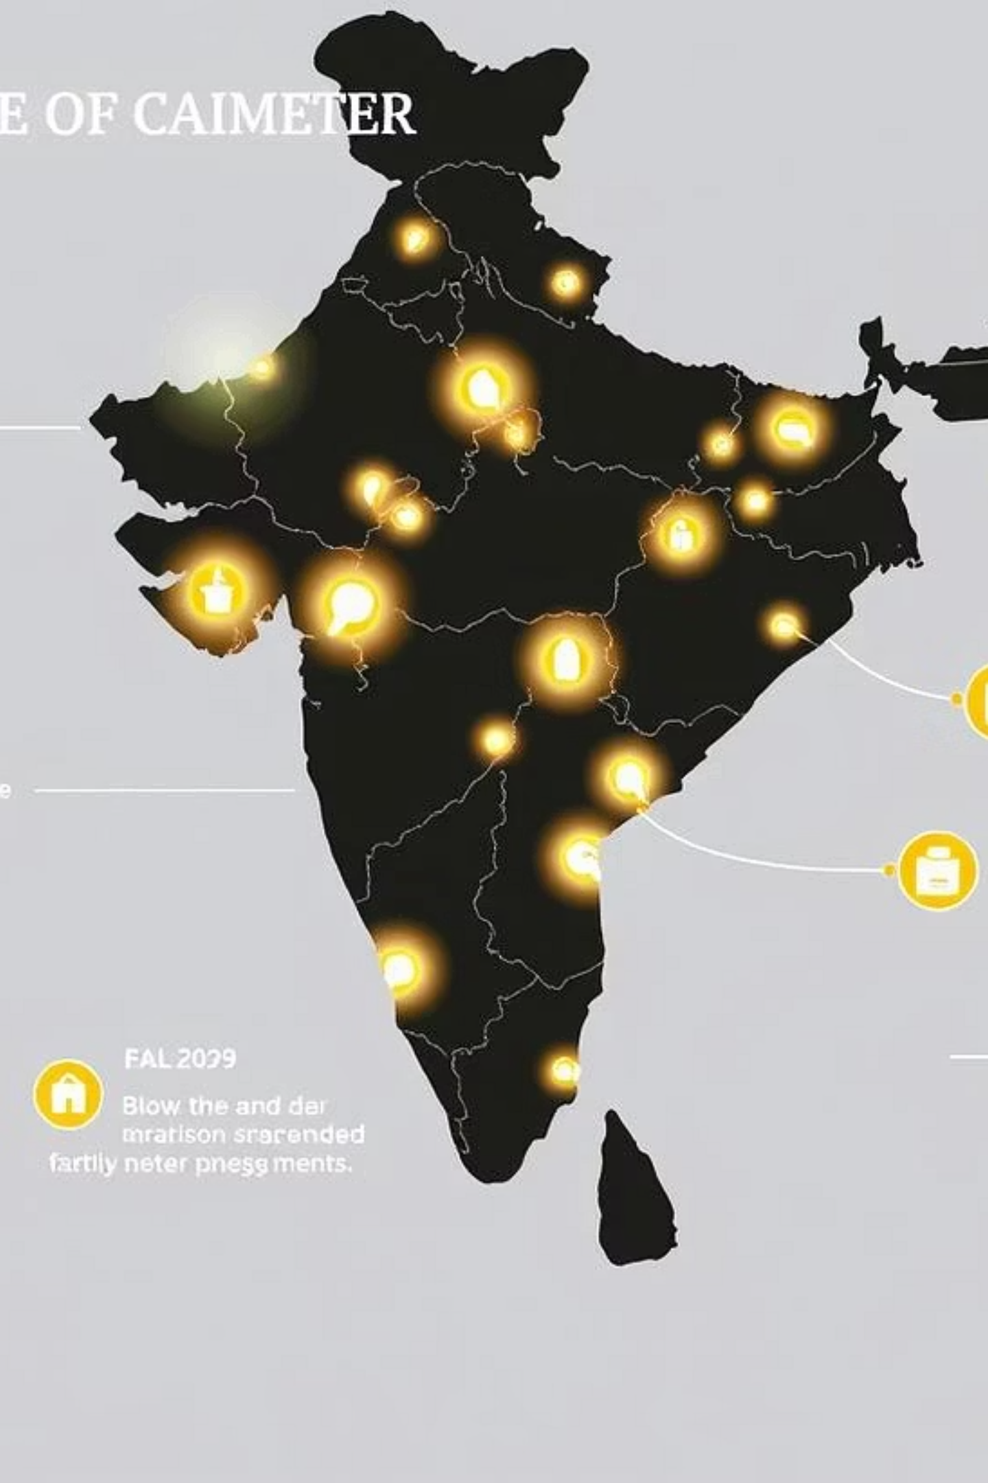
Market Size & Opportunity
250M+
₹9500
100%
Households
Unit Cost
Market Potential
In India and developing nations without smart meters.
Significantly more affordable than competitors (₹25,000+).
Opportunity for both urban and rural deployments.

Slide 8
Business & Revenue Model
B2C Sales
B2B2G Partnerships
Licensing Model
Direct sales to individual households.
Collaborations with utility providers and government bodies.
Licensing SECMS technology to other regions/companies.
Add-on Sales
Premium Analytics
Revenue from WattFinder plug-in modules.
Subscription for advanced app-based features.

Slide 9

Vision, Scalability & Impact
Supports India's Energy Goals: Aligns with national energy efficiency initiatives.
Global SDG 7 Alignment: Promotes affordable and clean energy worldwide.
Scalability: Potential to reach 10M+ homes across diverse regions.
Integration: Seamless integration with government energy schemes.
Carbon Footprint Reduction: Empowers users to reduce energy waste.
SECMS: Empowering a sustainable and digitized power ecosystem.

